Slide 1
Chapter 11
Configuring and Testing Your Network

Slide 2
These presentations are the result of a collaboration among the instructors at St. Clair College in Windsor, Ontario.
Thanks must go out to Rick Graziani of Cabrillo College. His material and additional information was used as a reference in their creation.

Slide 3
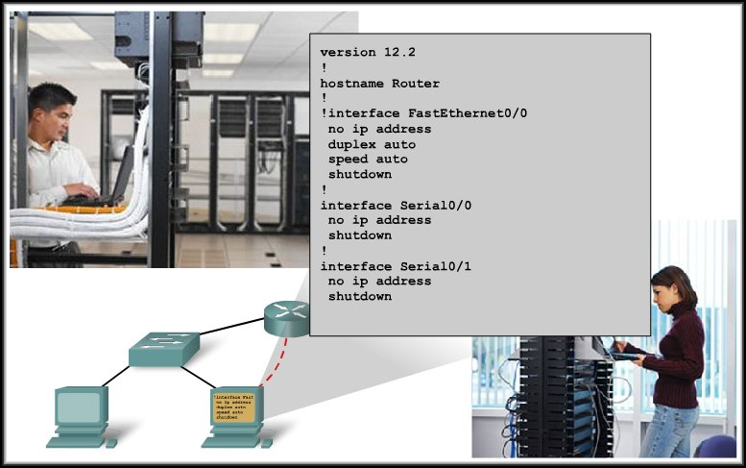
Configuring and Testing Your Network
Configuring Cisco Devices: IOS Basics

Slide 4
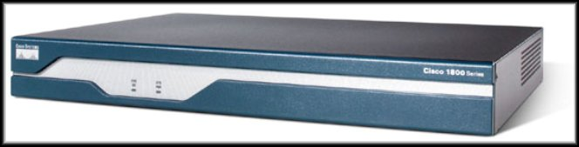
Cisco IOS
As with a computer, a router or switch cannot function without an operating system.
Cisco calls its operating system the Cisco Internetwork Operating System or Cisco IOS.
The Cisco IOS provides the following network services:
  Basic routing and switching functions
  Reliable and secure access to networked resources
  Network scalability

Slide 5
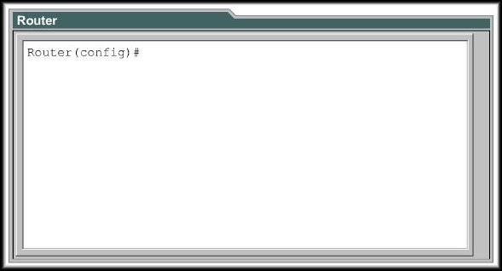
Cisco IOS
The Cisco IOS is accessed using the Command Line Interface (CLI).
Features will vary based on the version of the IOS and the type of device.

Slide 6
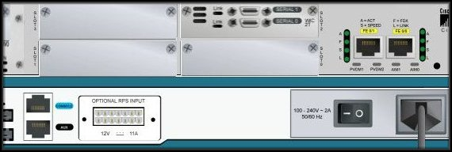
Access Methods
Telnet Access
Telnet or SSH
Serial Ports
Auxiliary Port
Console Port
Ethernet Ports
Modem Access
Terminal Access
Telnet Access

Slide 7
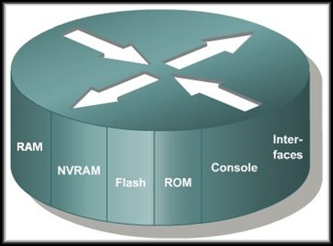
Router Components
The main internal components
of a router are:
  Random Access Memory
  (RAM)
  Nonvolatile Random Access
  Memory (NVRAM)
  Flash Memory (Flash)
  Read Only Memory (ROM)
  Console
  Interfaces

Slide 8
Router Components
Random Access Memory (RAM):
  Stores routing tables
  Holds ARP cache
  Holds fast-switching cache
  Performs packet buffering
  as shared RAM
  Maintains packet-hold queues
  Provides temporary memory for the configuration file of a router while the router is powered on
  Loses content when a router is powered down or restarted

Slide 9
Router Components
Nonvolatile Random Access
Memory (NVRAM):
  Provides storage for the
  startup configuration file
  Retains content when a
  router is powered down
  or restarted

Slide 10
Router Components
Flash Memory (Flash):
  Holds the IOS image
  Allows software to be
  updated without removing
  and replacing chips on the
  processor
  Retains content when a
  router is powered down or restarted
  Can store multiple versions of IOS software
  Is a type of electrically erasable programmable read-only memory (EEPROM)

Slide 11
Router Components
Read Only Memory (ROM):
  Maintains instructions for
  power-on self test (POST)
  diagnostics
  Stores the bootstrap program
  and the basic operating
  system software
  Requires replacing pluggable chips on the motherboard for software upgrades

Slide 12
Router Components
Console:
  The console port provides
  physical access for the initial
  configuration of the router or
  configuration changes.
Interfaces:
  Connect routers to a network for packet entry and exit
  They can be on the motherboard or on a separate module

Slide 13
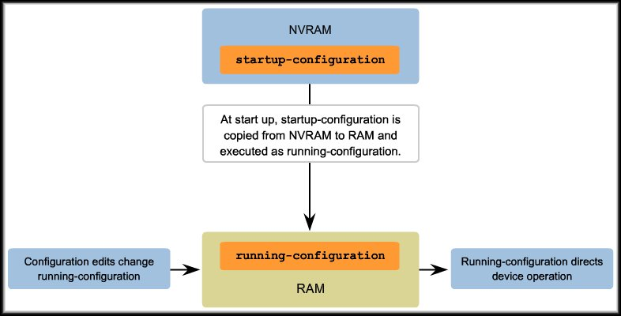
Configuration Files
Network devices depend upon two types of software:
  Operating system (IOS)
  Configuration file

Slide 14
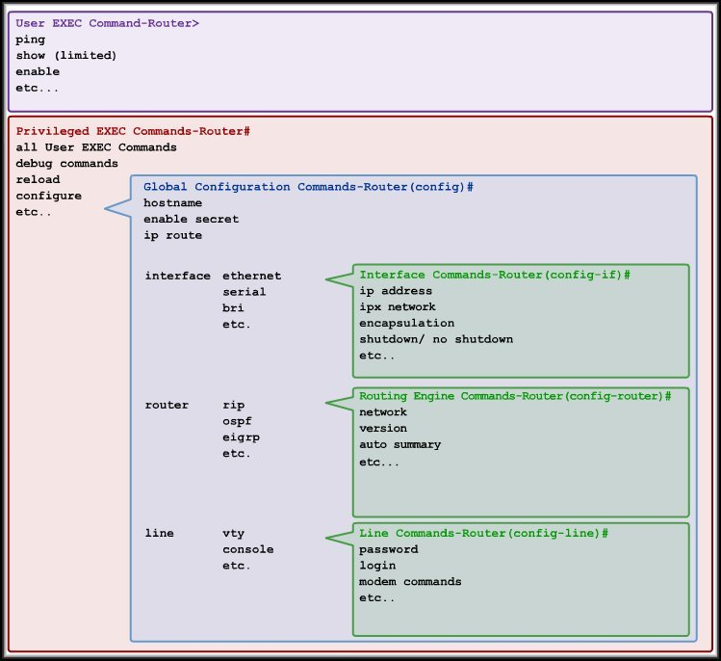
Cisco IOS Modes
Hierarchical Structure
Each mode used to accomplish particular tasks.
Each mode has a specific set of commands.

Slide 15
Cisco IOS Modes - Routers and Switches
Mode | Description | Prompts
User EXEC | Limited commands “View Only” Mode | Router>
Privileged EXEC | Configuration commands Debugging and testing File manipulation | Router#
Global Configuration | Commands for the router Entry to other modes | Router(config)#
Interface Configuration | Commands to configure an interface | Router(config-if)#
Line Configuration | Commands to configure console and telnet/ssh access | Router(config-line)#
Other modes | Specific service configuration (NAT / DHCP) | Router(config-mode)#

Slide 16
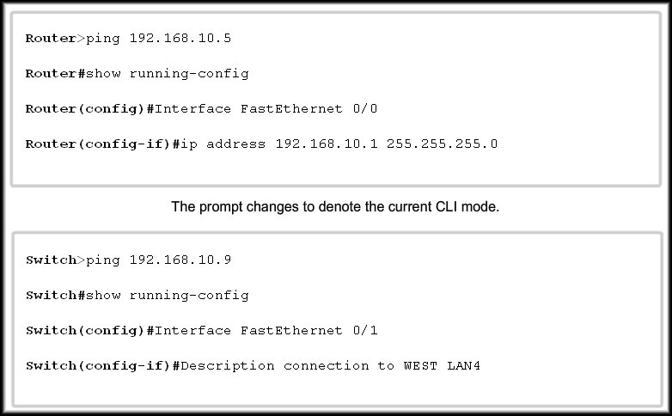
Cisco IOS Modes
User EXEC
Privileged EXEC
Global Configuration
Interface Configuration

Slide 17
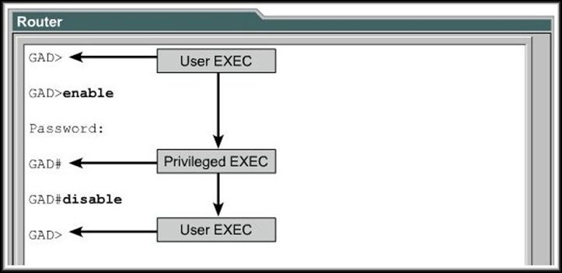
Moving Between User and Privileged EXEC
Use enable to move from User to Privileged EXEC.
Use disable or end to move back.

Slide 18
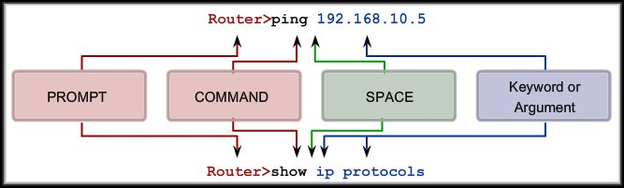
Basic IOS Command Structure
Router(config)#hostname MyRouter
MyRouter(config)#
Router(config)#interface fastethernet 0/0
Router(config-if)#
Router(config-if)# ip address 192.168.100.1 255.255.255.0
Router(config-if)#

Slide 19
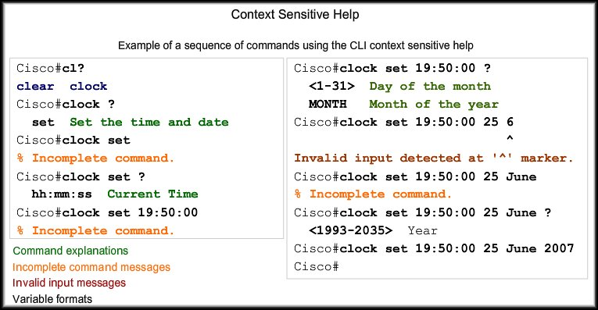
Using CLI Help

Slide 20
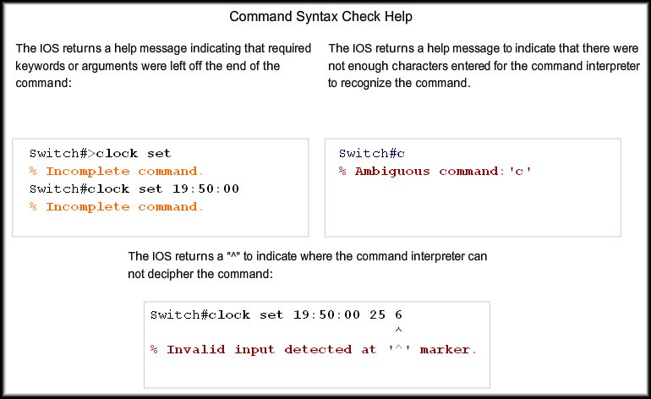
Using CLI Help

Slide 21
Using CLI Help
Hot Keys and Shortcuts:
  CLI Line Editing:
    Several outlined in the text.
    Backspace most often used.
      Note that the Delete key is NOT recognized to delete invalid characters.

Slide 22
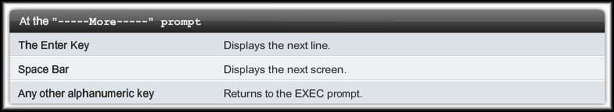
Using CLI Help
Hot Keys and Shortcuts:
  At the ----More---- Prompt:
    If the screen fills up with a display, the More prompt will be displayed.

Slide 23
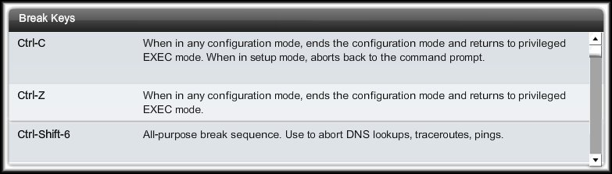
Using CLI Help
Break Keys:
  If you wish to abort a process or command…..

Slide 24
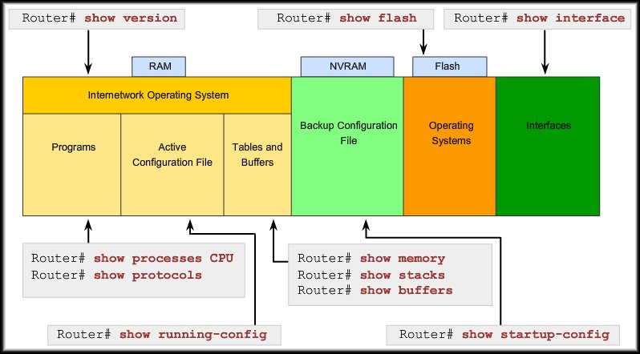
IOS Examination Commands
In order to verify and troubleshoot network operation, we must examine the operation of the devices.
The basic examination command is the show command.

Slide 25
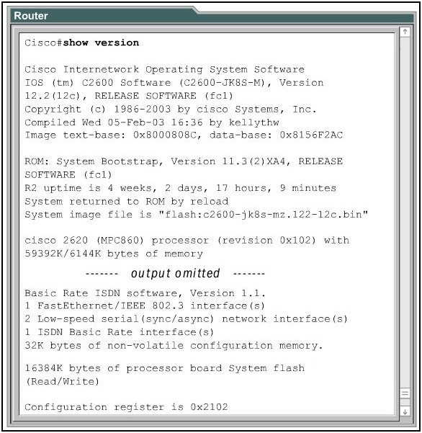
IOS Examination Commands – show version
IOS Version, Name
RAM
INTERFACES
FLASH
Configuration Register

Slide 26
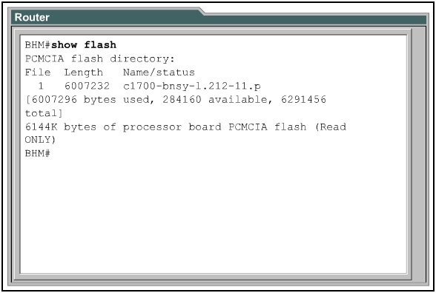
IOS Examination Commands – show flash
Use the show flash command to verify that the router has sufficient memory to load a new Cisco IOS software image.

Slide 27
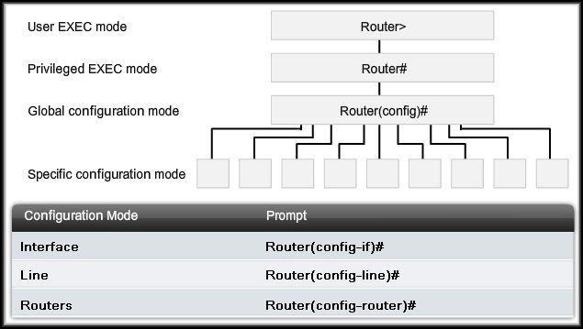
IOS Configuration Modes
enable
Exit / Ctrl/Z
configure terminal
interface / line / router

Slide 28
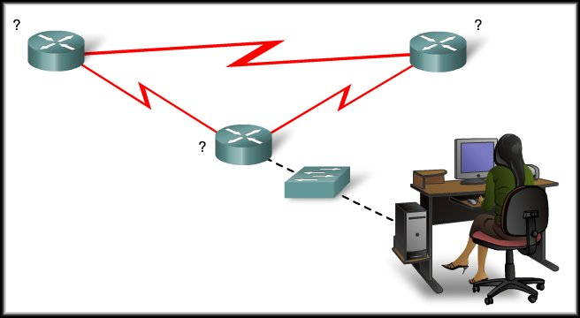
Configuring and Testing Your Network
Applying a Basic Configuration

Slide 29
Naming Devices
Importance of a Device Name:
  Default “Router” or “Switch”
  Host Name appears as the CLI prompt.
  Confirmation that the correct device has been accessed.
  Naming convention makes maintenance easier.
    Start with a letter
    No spaces
    End with letter or digit
    Only letters, digits and dashes
    Maximum of 63 characters

Slide 30
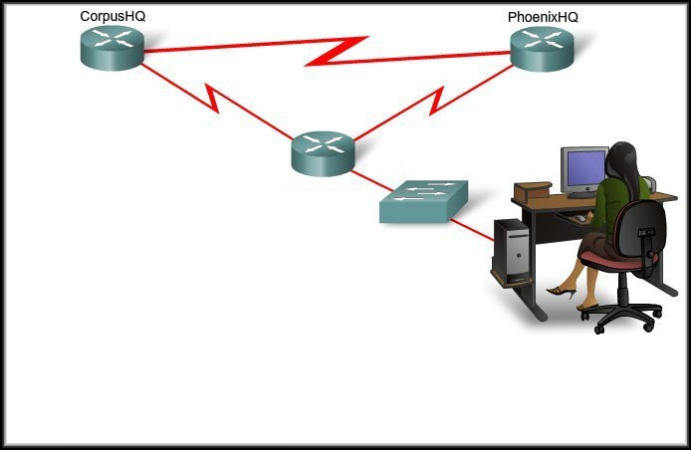
Naming Devices
AtlantaHQ
Router>
Router>enable
Router#
Router#configure terminal
Router(config)#
Router(config)#hostname AtlantaHQ
AtlantaHQ(config)#

Slide 31
Naming Devices
AtlantaHQ
Flour_Bluff
Switch>
Switch>enable
Switch#
Switch#configure terminal
Switch(config)#
Switch(config)#hostname Flour_Bluff
Flour_Bluff(config)#

Slide 32
Limiting Device Access
Configuring Passwords:
  Passwords are the primary defense against unauthorized access to network devices.
    Every device should have locally configured passwords to limit access.
  Console password:
    Limits device access using the console connection
  Enable password:
    Limits access to the privileged EXEC mode
  Enable secret password:
    Encrypted, limits access to the privileged EXEC mode
  VTY password: Limits device access using Telnet / SSH

Slide 33
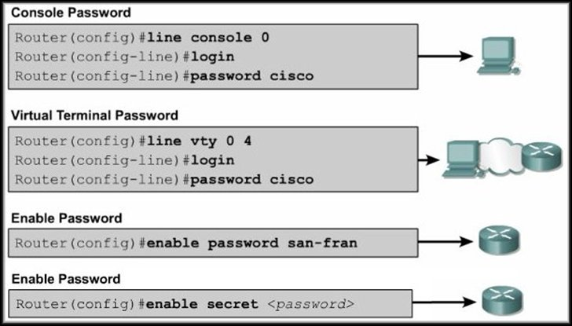
Limiting Device Access

Slide 34
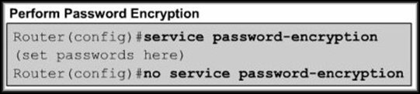
Limiting Device Access
Encrypting Password Display:
  The service password-encryption command prevents ALL passwords from showing up as plain text when viewing the configuration files.
service password-encryption uses a Cisco Level 7 encryption which is very easy to decrypt.

Slide 35
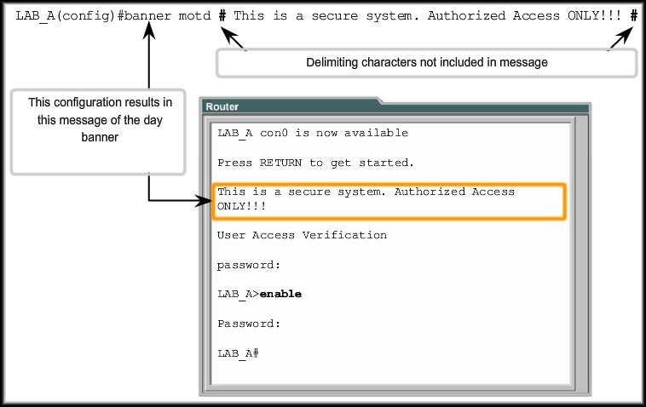
Limiting Device Access
Login Banner:

Slide 36
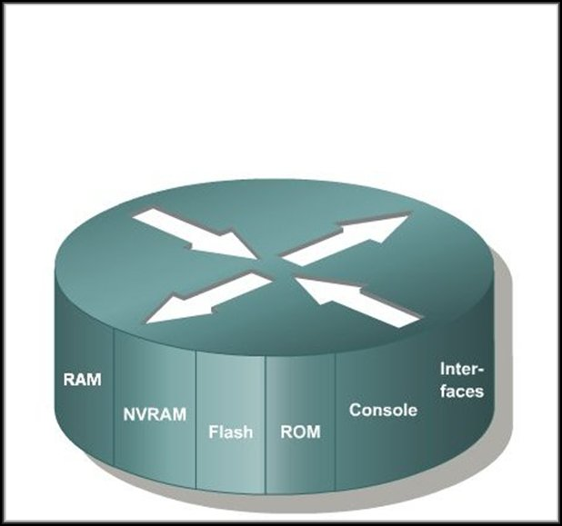
Managing Configuration Files
running-config
(IOS running)
startup-config
IOS
Boot Program

Slide 37
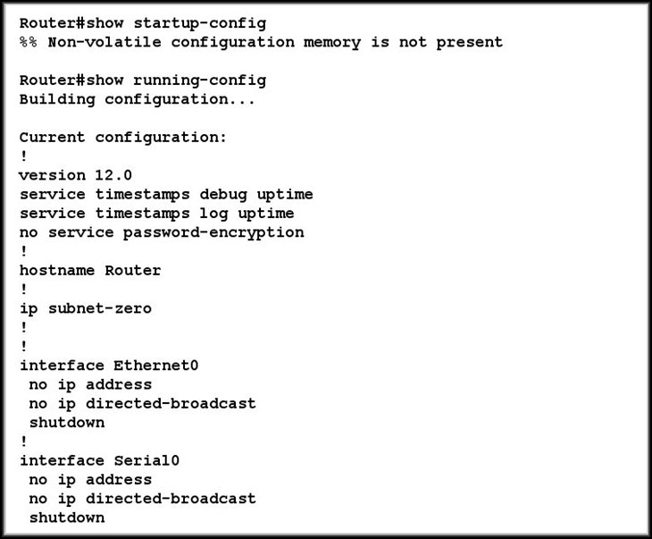
Managing Configuration Files
No startup-config file in NVRAM
Default running-config file, created in RAM

Slide 38
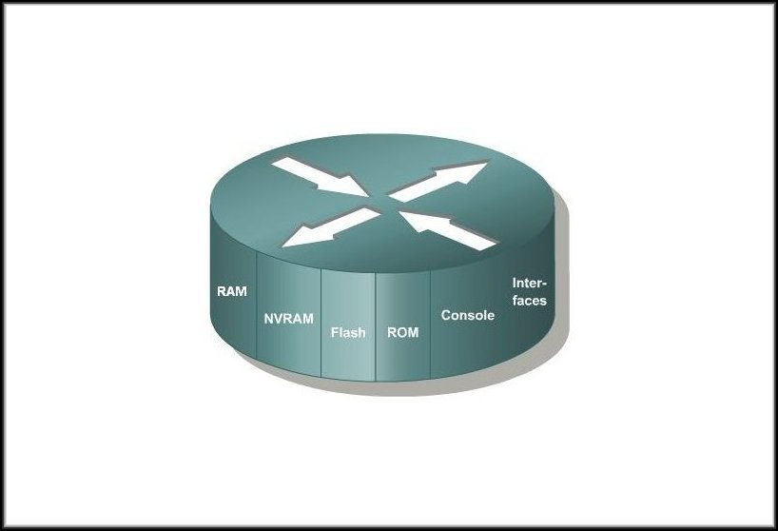
Managing Configuration Files
running-config
resides here
startup-config
resides here
At boot up, running-config is replaced
by startup-config….

Slide 39
Managing Configuration Files
If the router loses power or reboots, everything in RAM is lost including the running-config file.
running-config
resides here
Changes to the router are automatically put in the running-config file.

Slide 40
Managing Configuration Files
running-config
resides here
startup-config
resides here
To make sure that router changes are saved…
copy running-config startup-config

Slide 41
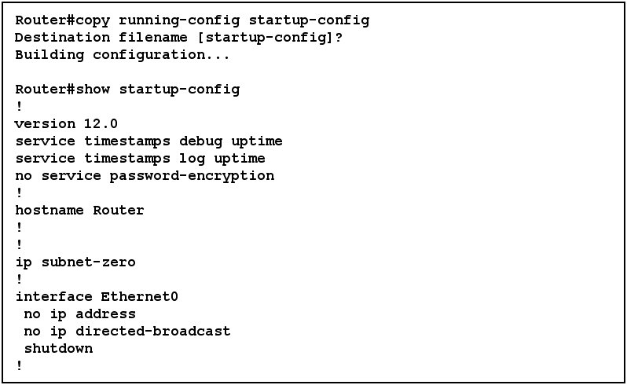
Managing Configuration Files
The startup-config file is now identical to running-config and the router will have these changes if the router reboots.

Slide 42
Managing Configuration Files
Router# copy running-config startup-config
OR
Router# copy running startup
OR
Router# copy run start
Any usage of the command or parameters,
so that they are
still uniquely recognizable.

Slide 43
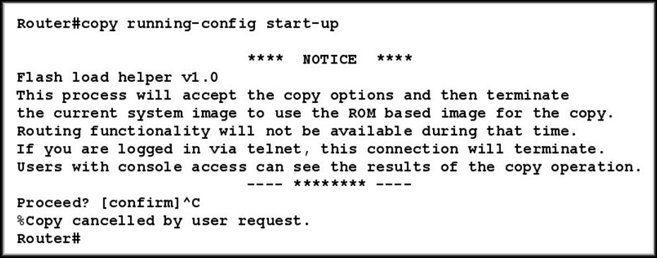
Managing Configuration Files -
WARNING
Using an incorrect configuration file name could overwrite a file in flash, as the router believes you are trying to copy a blank file into flash.
Incorrect destination
file name
Cancel it with Ctrl-C!

Slide 44
Managing Configuration Files
Returning the Device to its Original Configuration:
  reload command
    Works ONLY IF the running configuration has NOT been copied to the startup configuration.
Router# reload
System configuration has been modified. Save? [yes/no]: n
Proceed with reload? [confirm] Press Enter
*Apr 13 01:34:15.758: %SYS-5-RELOAD: Reload requested by console.
Reload Reason: Reload Command.

Slide 45
Managing Configuration Files
Backing Up Configurations Offline:
  TFTP server
  CD
  USB Memory Stick
    Text Files using the Clipboard.
    Text files using HyperTerminal capture.
Restoring Configurations:
  TFTP Server
  Paste to Host from a text file.

Slide 46
Managing Configuration Files
A TFTP server will allow image and configuration uploads and downloads over the network.
The TFTP server can be another router, or it can be a host system.

Slide 47
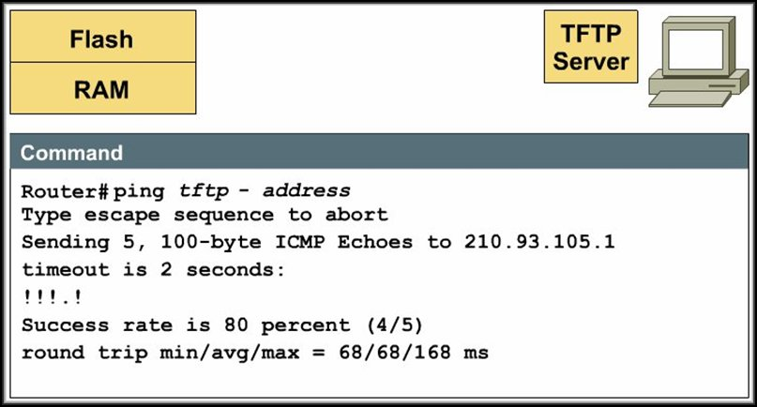
Managing Configuration Files
Once it is installed or before you attempt to use it, ALWAYS make sure that the connectivity is there….

Slide 48
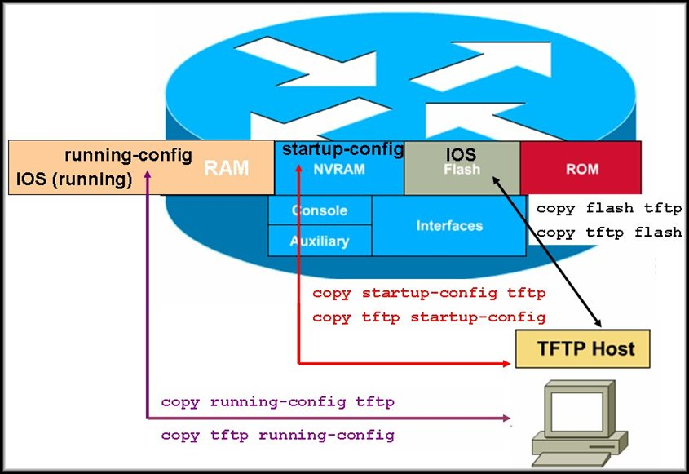
Managing Configuration Files
What can be copied?

Slide 49
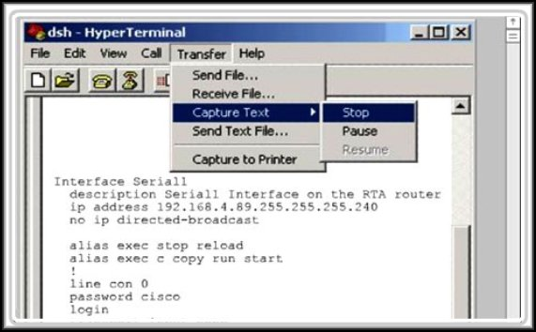
Managing Configuration Files
Configuration files can be captured and saved in text format using the text capture function of HyperTerminal (or any other emulator that has the function).

Slide 50
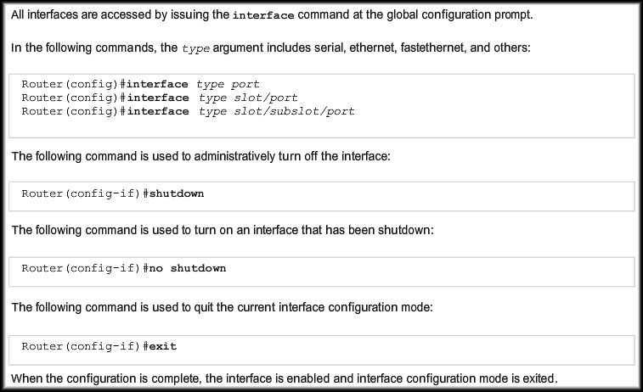
Configuring Interfaces
Router Interfaces

Slide 51
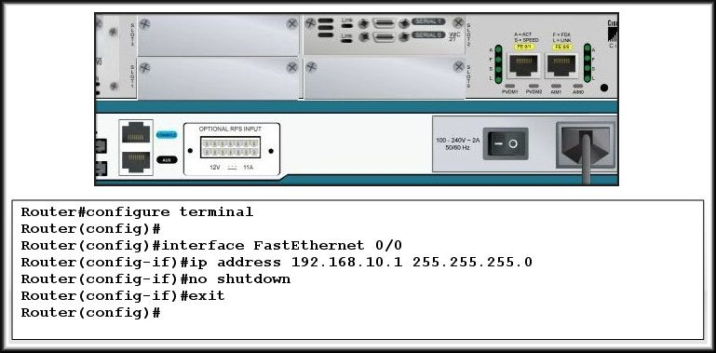
Configuring Interfaces
Configuring a Router Ethernet Interface:

Slide 52
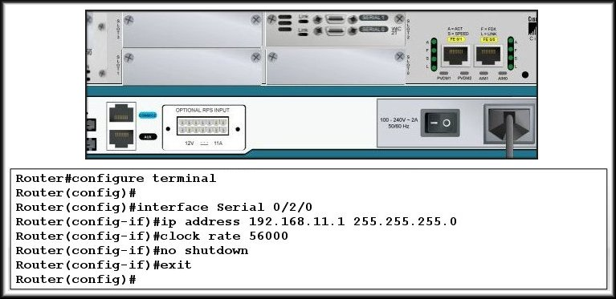
Configuring Interfaces
Configuring a Router Serial Interface:

Slide 53
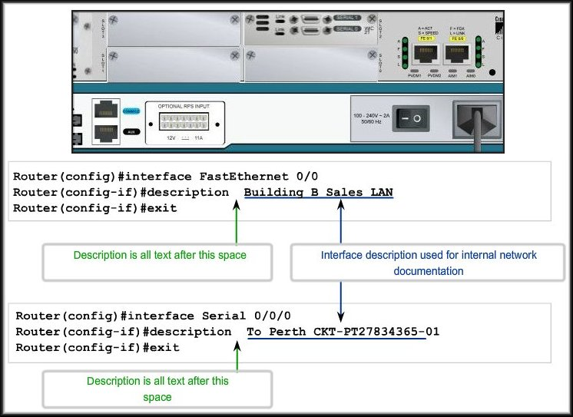
Describing Router Interfaces

Slide 54
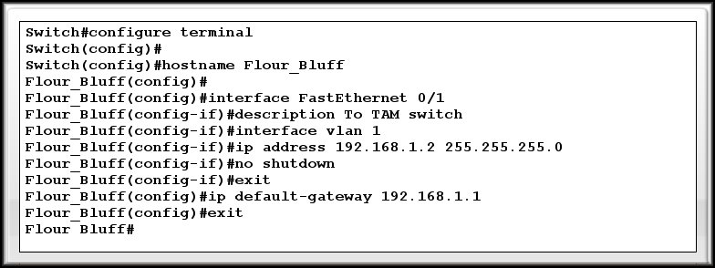
Configuring Interfaces
Configuring a Switch:

Slide 55
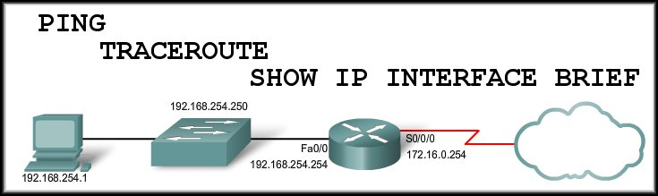
Configuring and Testing Your Network
Verifying Connectivity

Slide 56
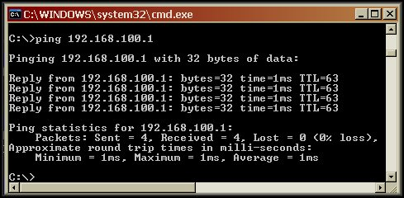
Test the Stack
PING:
  From the command window on a PC.

Slide 57
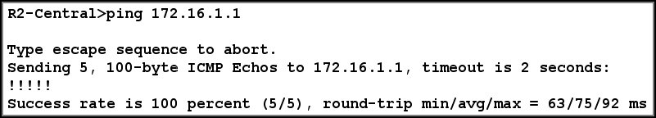
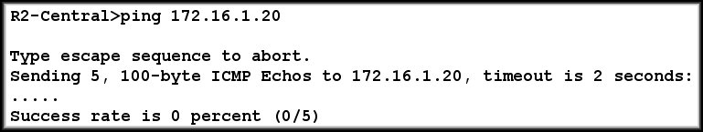
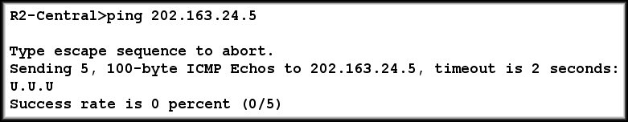
Test the Stack
PING:
  From the router IOS.

Slide 58
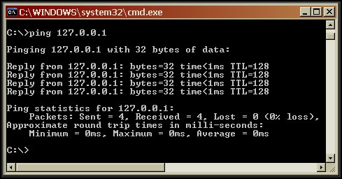
Test the Stack
PING:
  Testing the Loopback (127.0.0.1).
If successful, it means that the protocol stack on the PC is functioning properly from the Network through the Physical Layers.

Slide 59
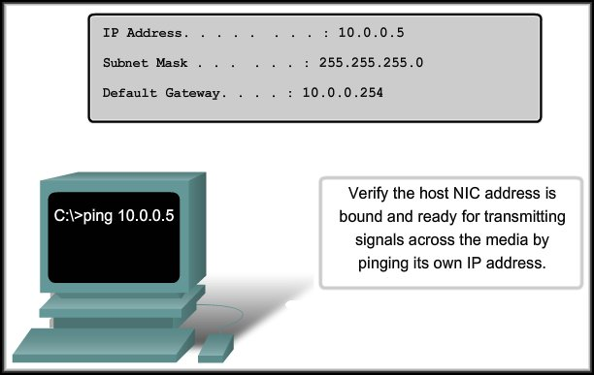
Testing the Local NIC Assignment

Slide 60
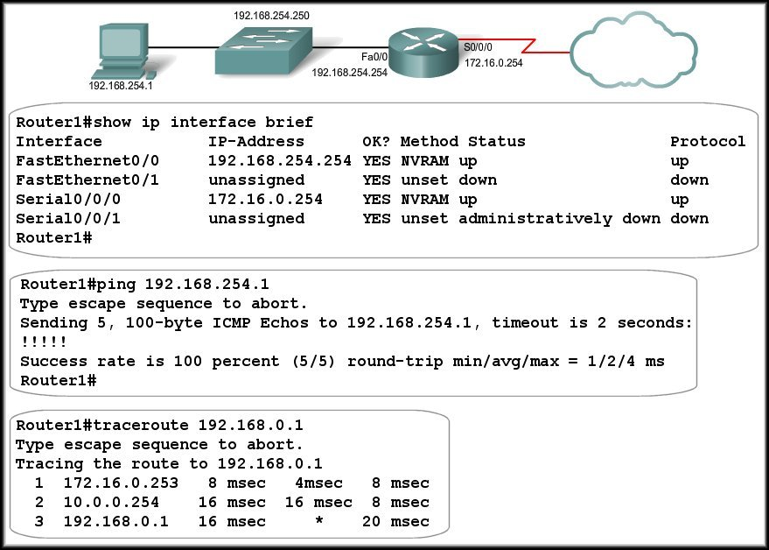
Testing the Router Interfaces

Slide 61
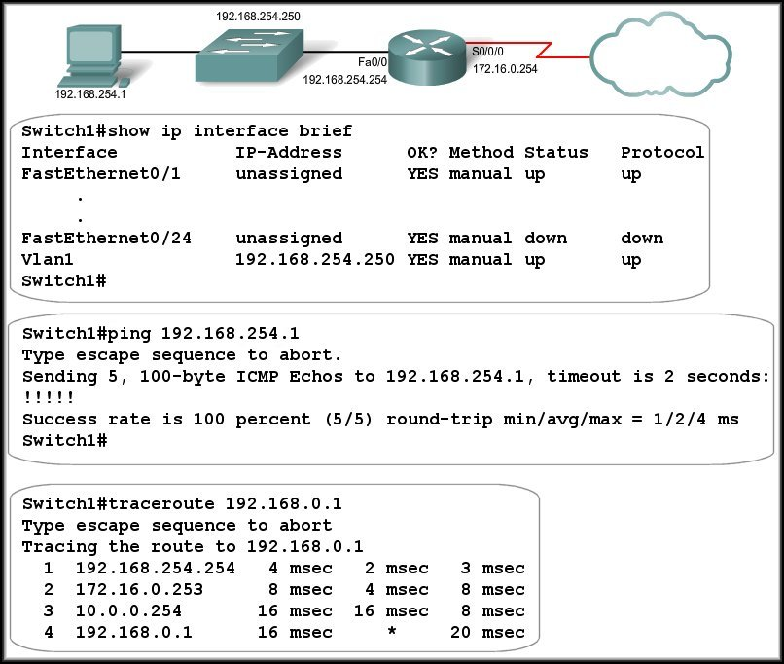
Testing the Switch Interfaces

Slide 62
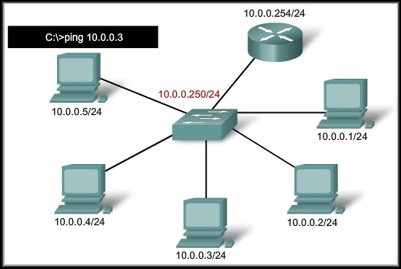
Testing the Local Network
Successfully pinging another host on the same subnet verifies that both the local host and the other host are configured correctly.

Slide 63
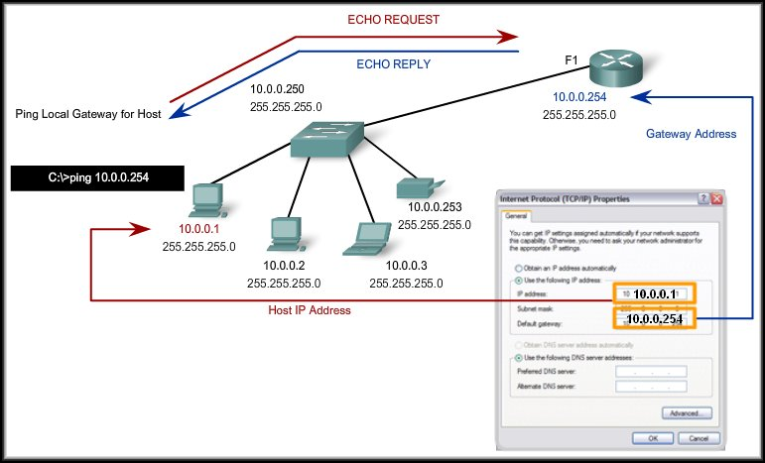
Testing Gateway Connectivity
A successful ping verifies both the host and gateway configurations.

Slide 64
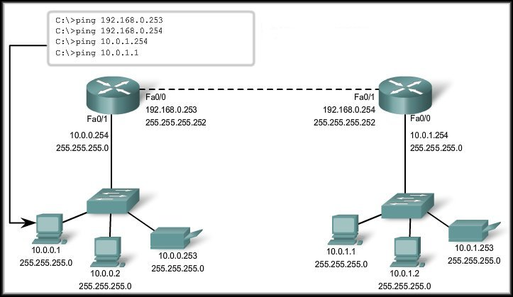
Testing Remote Connectivity
Ping each hop between the local and remote host.

Slide 65
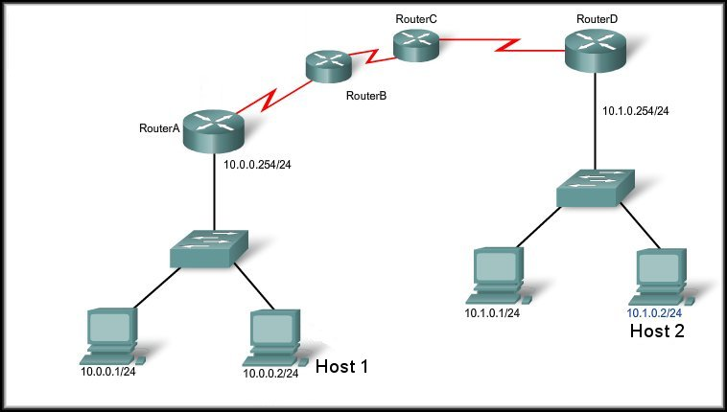
Tracing and Interpreting Trace Results
C:\ping 10.1.0.2
Pinging 10.1.0.2 with 32 bytes of data:
Request timed out.
Request timed out.
Request timed out.
Request timed out.
Ping statistics for 10.1.0.2:
Packets: Sent = 4, Received = 0, Lost = 4 (100% loss)
The ping test failed.
Problem somewhere past this point.
C:\>tracert 10.1.0.2
Tracing route to 10.1.0.2 over a maximum of 30 hops
1 2 ms 2 ms 2 ms 10.0.0.254
2 * * * Request timed out.
3 * * * Request timed out.
4 ^C

Slide 66
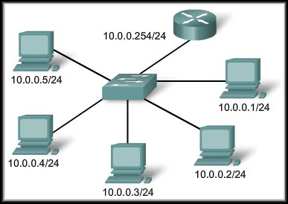
Configuring and Testing Your Network
Monitoring and Documenting Networks

Slide 67
Basic Network Baselines
Network Baseline:
  Process for studying the network at regular intervals.
  Ensure that the network is working as designed.
  More than a single report.
  Health of the network at a certain point in time.
  Accomplished over a period of time.
  Varying times and loads will assist in creating a better picture of overall network performance.
    Copy and paste the results from an executed ping, trace, or other relevant command into a text file.
    Compare the results over time.

Slide 68

Basic Network Baselines
Run the same test.
At different times.
Compare the results.

Slide 69
Basic Network Baselines
Network Baseline:
  Results from a command can be captured and saved as a text file for future study.
    PING
    TRACEROUTE
    CISCO IOS

Slide 70

Learning About the Nodes on the Network

Slide 71

Ping Sweep / MAC Scanner Tools

Slide 72

Switch Connections

